Slide 1












Slide 2
















Slide 3





















Slide 4






























Slide 5



























Slide 6





package my.demo
import kotlin.text.*
fun main(args: Array<String>) {
println(args.contentToString())
println("Enter any word: ")
val yourWord = readln()
print("You entered the word: ")
print(yourWord)
}

Slide 7
fun printSum(a: Int, b: Int): Unit {
println("sum of $a and $b is ${a + b}")
}
val user: User? = getUser()
val imageUrl = user?.friend?.photo?.image?.imageUrl

Slide 8


data class User(val name: String, val id: Int)
val user = User("Alex", 1)
println(user)
// User(name=Alex, id=1)
val user = User("Alex", 1)
val secondUser = User("Alex", 1)
// Compares user to second user
println("user == secondUser: ${user == secondUser}")
// user == secondUser: true
// Creates an exact copy of user
println(user.copy())
// User(name=Alex, id=1)
// Creates a copy of user with name: "Max"
println(user.copy("Max"))
// User(name=Max, id=1)

Slide 9
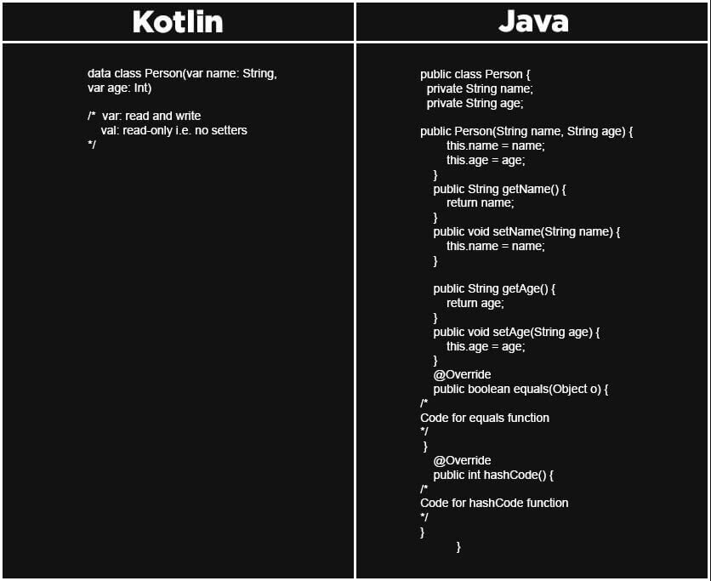

Slide 10













fun <T> applyFunction(x: T, func: (T) -> T): T {
return func(x)
}
fun increment(x: Int): Int = x + 1
fun main() {
val result = applyFunction(5, ::increment)
println(result) // Вывод: 6
}

Slide 11
















val double = { x: Int -> x * 2 }
fun main() {
val result = double(4)
println(result) // Вывод: 8
}

Slide 12

val immutableList = listOf(1, 2, 3)
fun main() {
// immutableList.add(4) // Ошибка компиляции
val newList = immutableList + 4
println(newList) // Вывод: [1, 2, 3, 4]
}

Slide 13



fun add(a: Int, b: Int): Int = a + b
fun main() {
println(add(2, 3)) // Вывод: 5
println(add(2, 3)) // Всегда возвращает 5 для тех же аргументов
}

Slide 14

















infix fun Int.shl(x: Int): Int { ... }
// calling the function using the infix notation
1 shl 2
// is the same as
1.shl(2)

Slide 15





fun add(a: Int) = { b: Int -> a + b }
fun main() {
val addFive = add(5)
println(addFive(3)) // Вывод: 8
}

Slide 16







val numbers = listOf(1, 2, 3, 4, 5)
fun main() {
val doubled = numbers.map { it * 2 }
val evenNumbers = numbers.filter { it % 2 == 0 }
val sum = numbers.reduce { acc, i -> acc + i }
println(doubled) // Вывод: [2, 4, 6, 8, 10]
println(evenNumbers) // Вывод: [2, 4]
println(sum) // Вывод: 15
}

Slide 17



data class Person(val name: String, val age: Int)
fun main() {
val person = Person("Alice", 30)
val (name, age) = person
println("Name: $name, Age: $age") // Вывод: Name: Alice, Age: 30
when (person.age) {
in 0..17 -> println("${person.name} is a minor")
in 18..64 -> println("${person.name} is an adult")
else -> println("${person.name} is a senior")
}
// Вывод: Alice is an adult
}

Slide 18





























